Slide 1
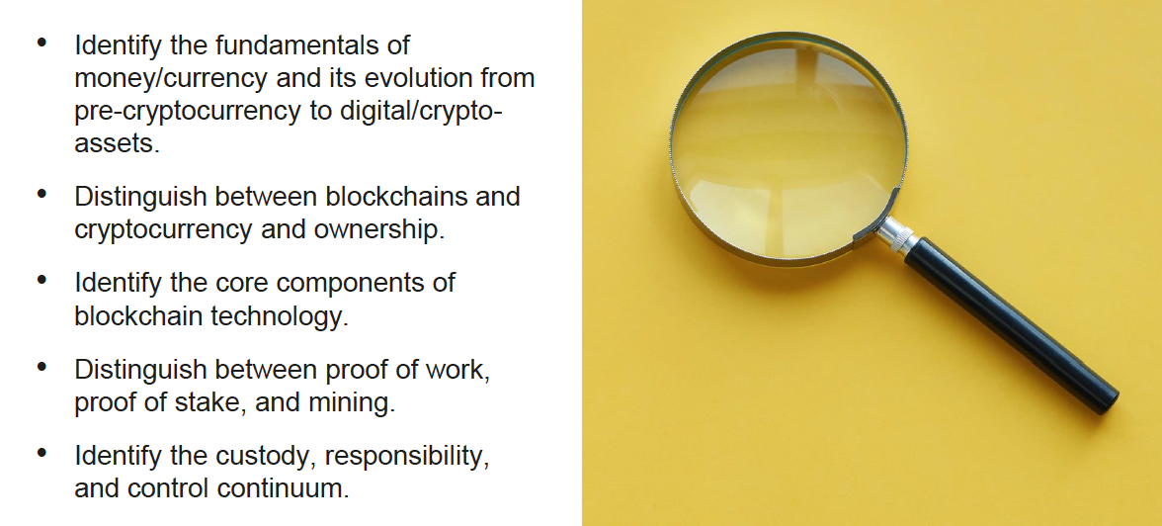
Objectives

Slide 2
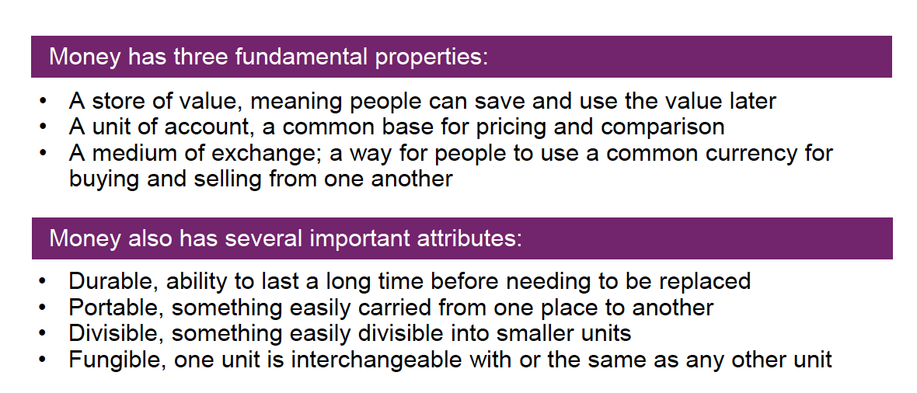
Fundamentals of money/currency

Slide 3
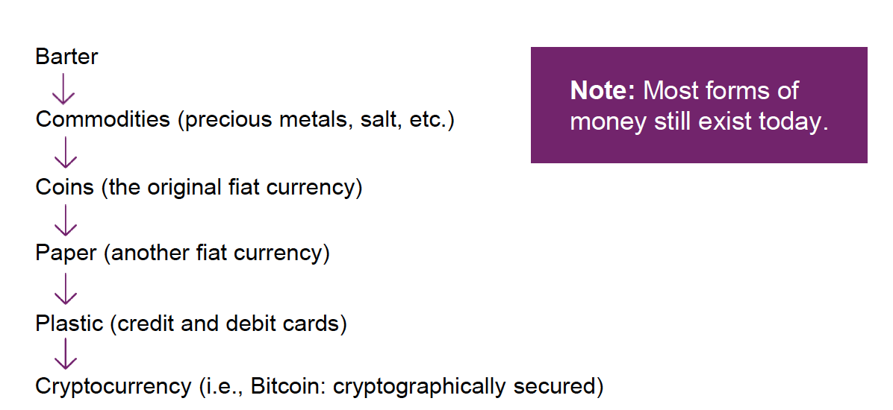
A brief currency timeline

Slide 4
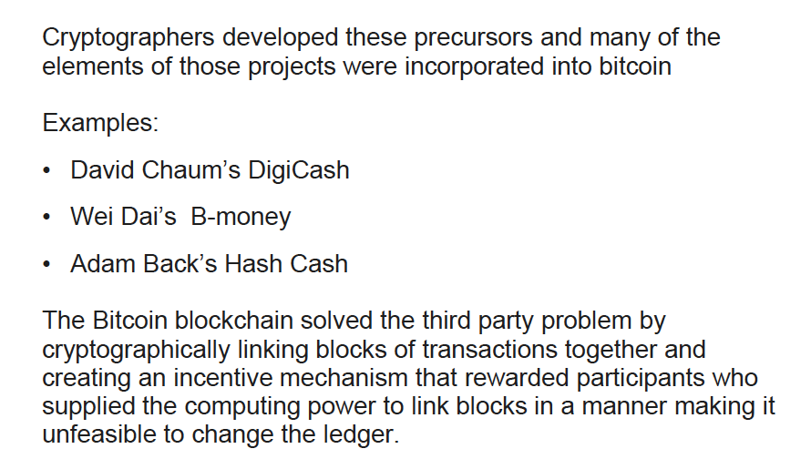
Pre-cryptocurrency history

Slide 5
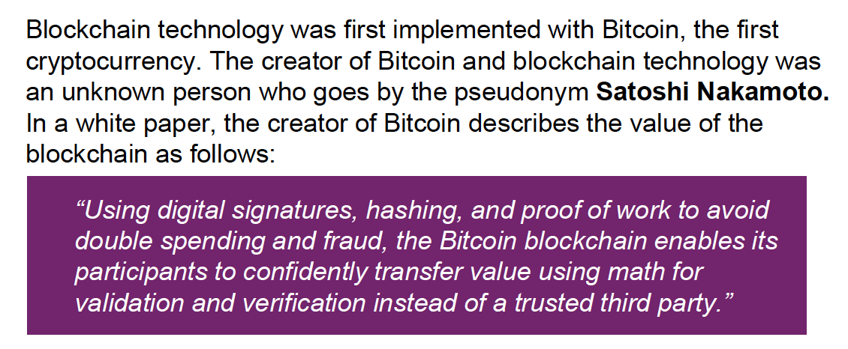
The Bitcoin white paper started it all

Slide 6
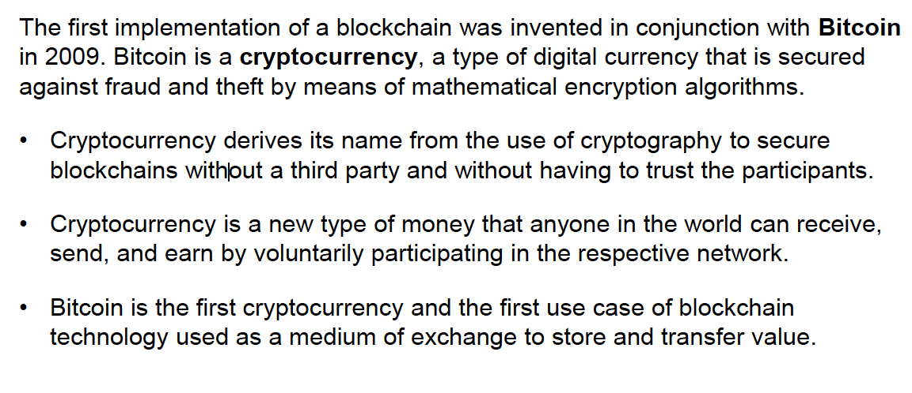
Blockchain, cryptocurrency, and Bitcoin

Slide 7
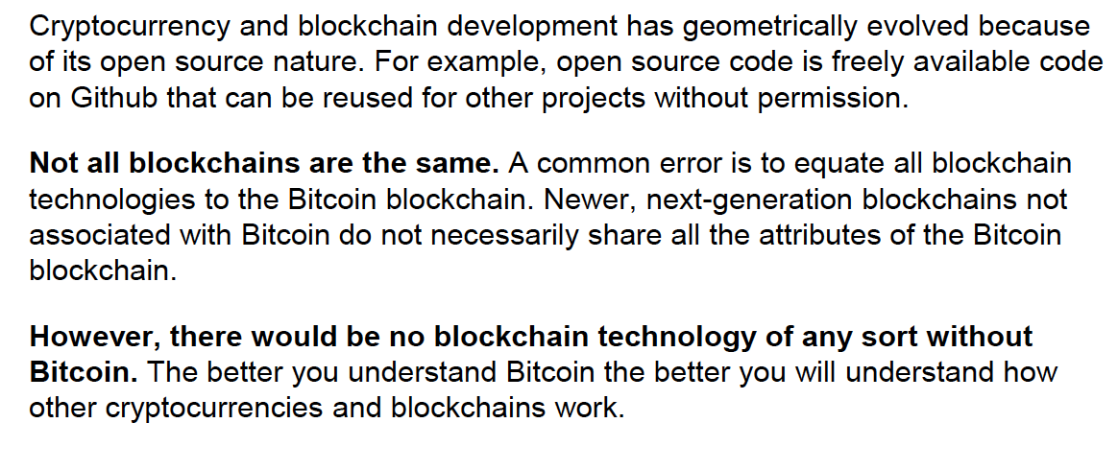
Blockchain, cryptocurrency, and Bitcoin

Slide 8
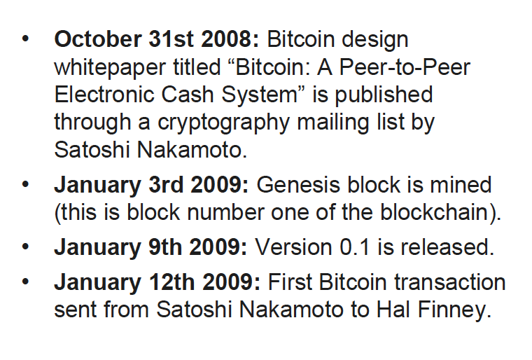

Birth of Bitcoin and the blockchain
This Photo by Unknown Author is licensed under CC BY-ND

Slide 9

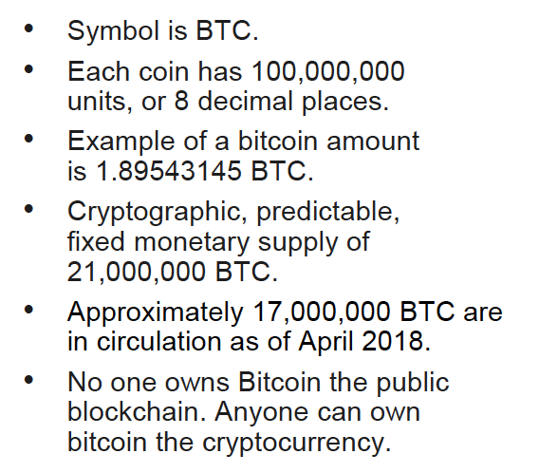
Bitcoin and blockchain characteristics

Slide 10
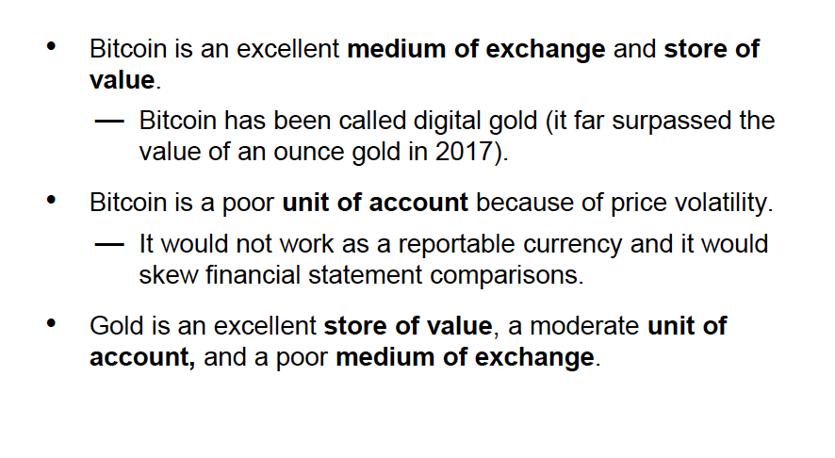
Bitcoin, gold, and the fundamentals of money

Slide 11
Bitcoin and blockchain: Additional characteristics
Peer to peer transactions
No intermediaries or trusted third parties
Public ledger transparency (transactions and ownership can be independently verified)
Sets the new standard for immutability (best example in history)
Eliminates some types of fraud
No more PCI compliance (as required for credit cards)
Send a transaction 24/7 without permission to anyone in the world

Slide 12
The distinction of the record versus ownership
The Record
The blockchain is a ledger representing the transfer of all bitcoin back to the genesis block. This is similar to other cryptocurrencies.
The record of the transfer of ownership is cryptographically secured with the blockchain.
Ownership of Cryptocurrency
The owners (individuals or organizations) still have to secure their cryptocurrency by storing a private key like a digital pen for signing transactions.
This is similar to managing cash, gold, or other assets. Poor management leads to the risk of loss.

Slide 13
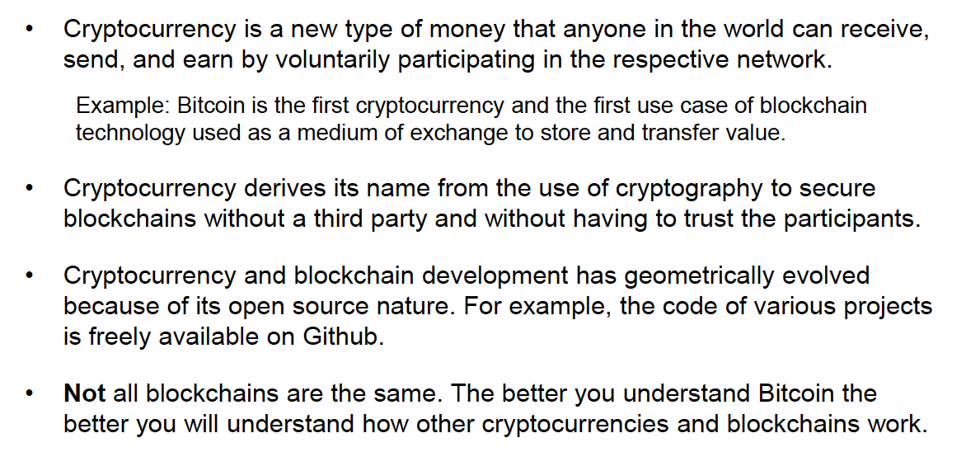
Bitcoin characteristics summarized

Slide 14
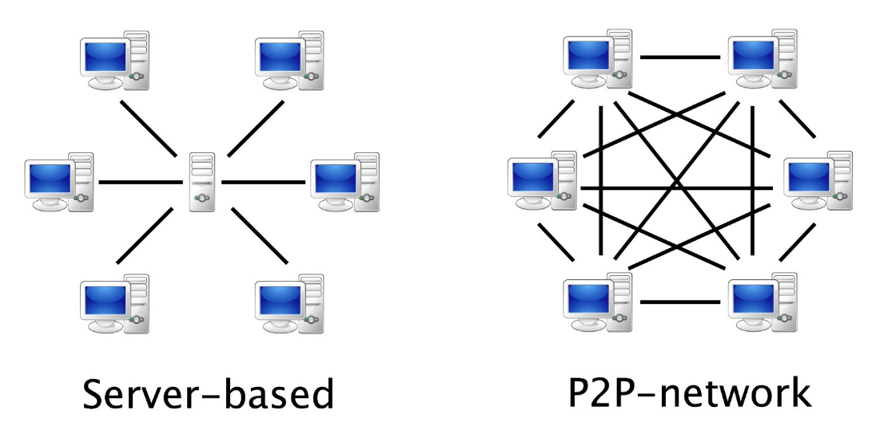
What is Blockchain?
A blockchain is a digital ledger created to capture transactions conducted among various parties in a network. It is a peer-to-peer, internet-based distributed ledger which includes all transactions since its creation. All participants (individuals or businesses) using the shared database are "nodes" connected to the blockchain, each maintaining an identical copy of the ledger.

Slide 15
Blockchain: Core Components of Technology
The ledger: A blockchain itself is the record of all transactions.
Peer-to-peer network: A large number of nodes (computers) connected over the internet in a decentralized fashion.
Consensus mechanism: A process using protocols and algorithms so nodes (computers) can agree on the same version (state) of the blockchain without having to know or trust one another.
Incentive mechanism: The native currency (bitcoin for example) that incentivizes participation to secure the decentralized network. The issuance of bitcoin is part of the consensus mechanism.

Slide 16
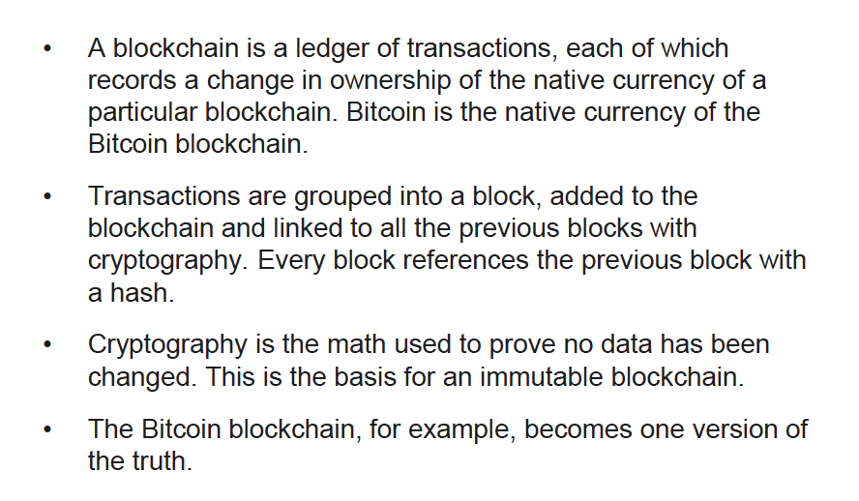
Core component 1: The ledger

Slide 17
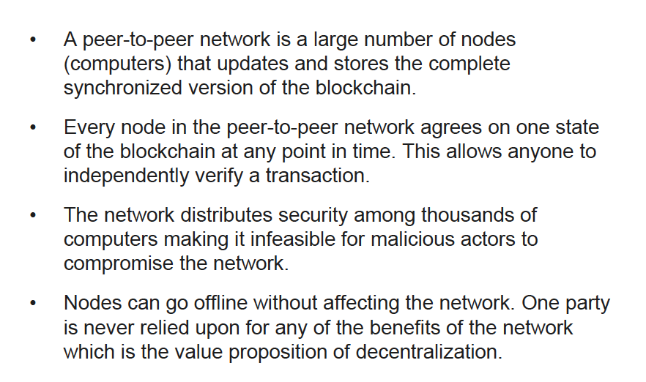
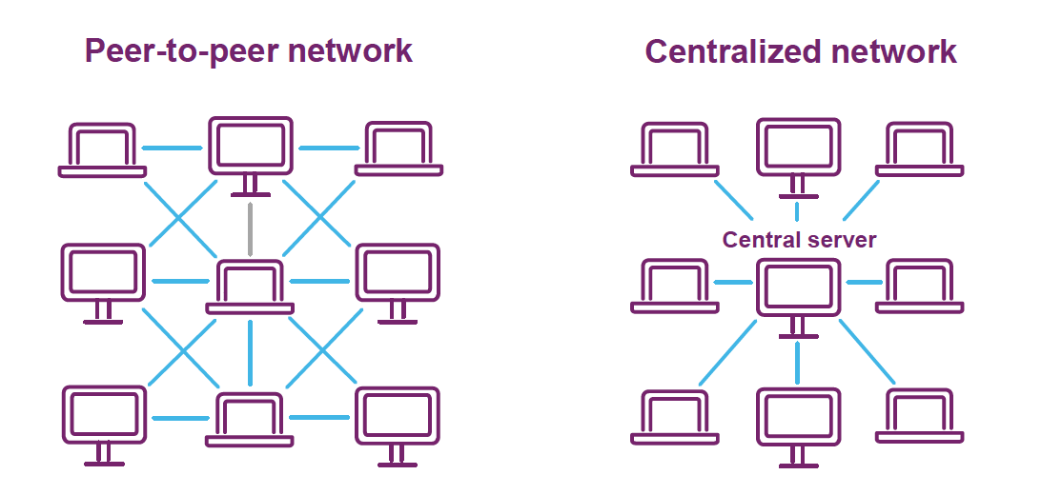
Core component 2: Peer-to-peer network

Slide 18
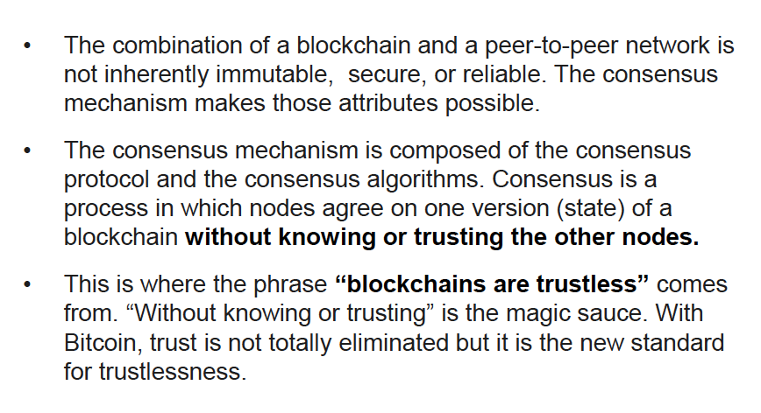
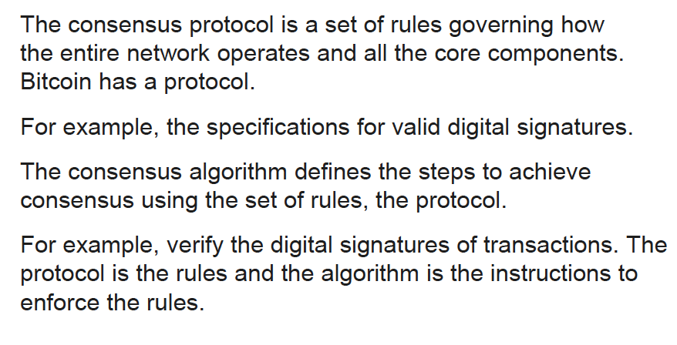
Core component 3: Consensus mechanism

Slide 19
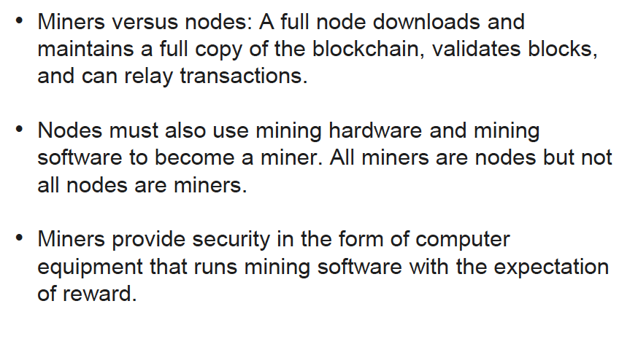
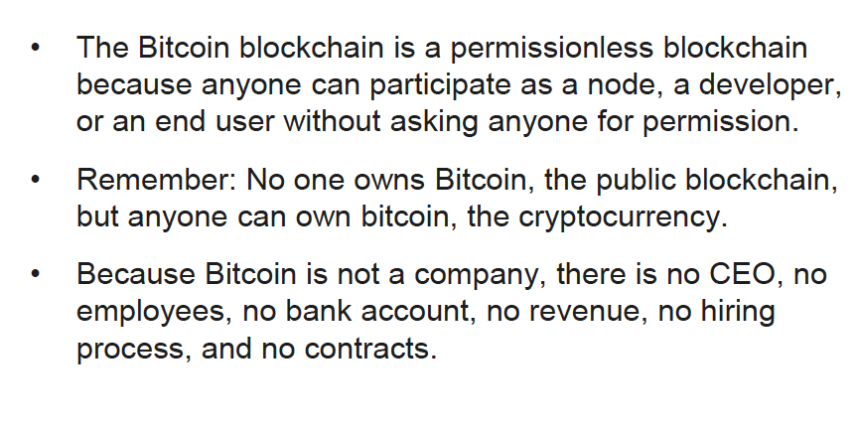
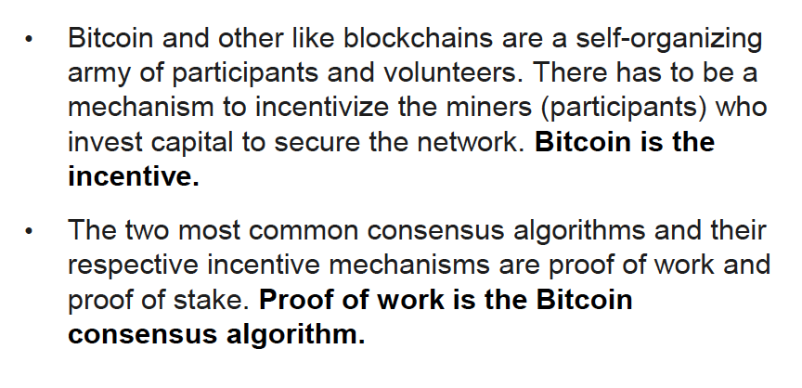
Core component 4: Incentive mechanism

Slide 20
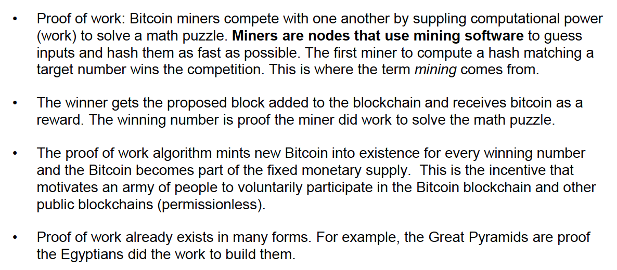
Core component 4: Incentive mechanism - POW

Slide 21
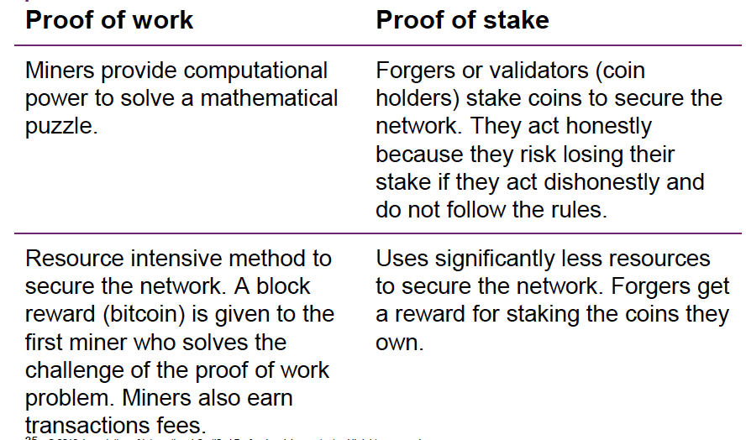
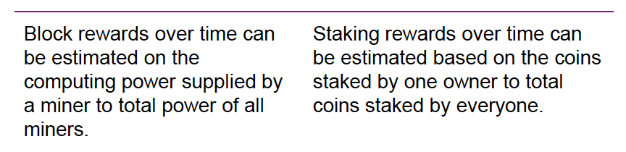
Consensus algorithms: Proof of work versus proof of stake

Slide 22
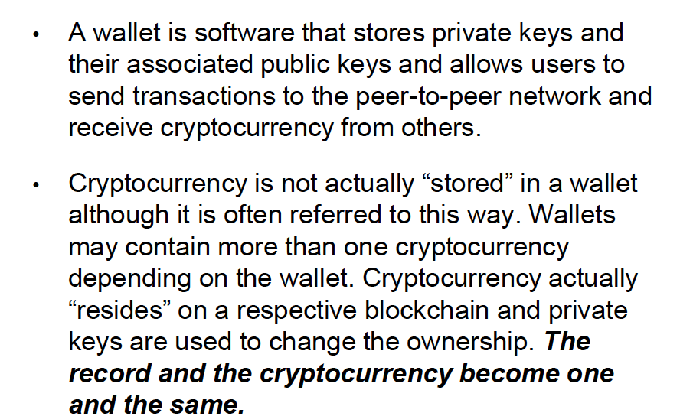
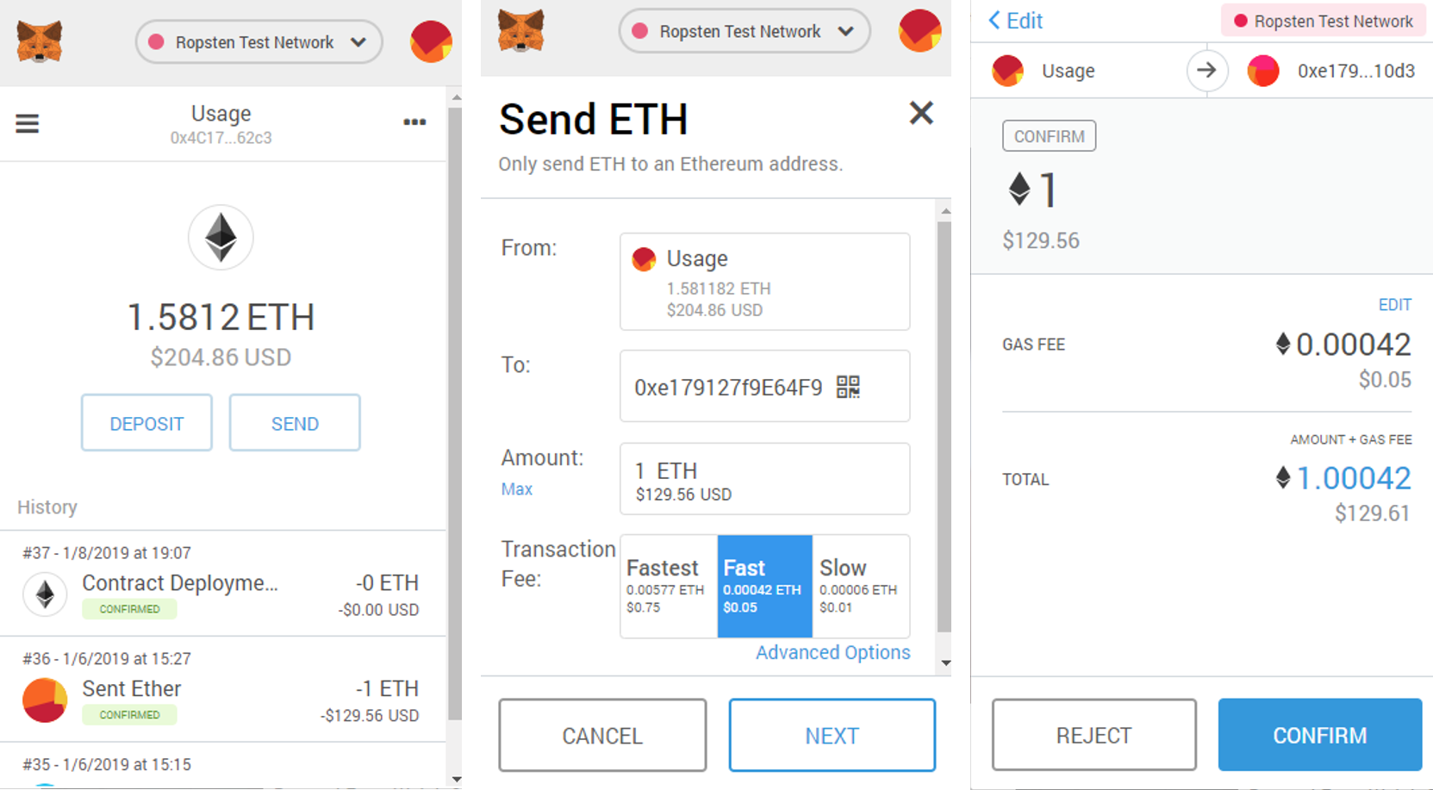
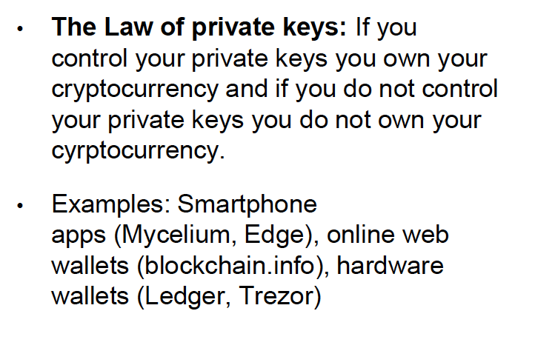
Cryptocurrency wallets

Slide 23
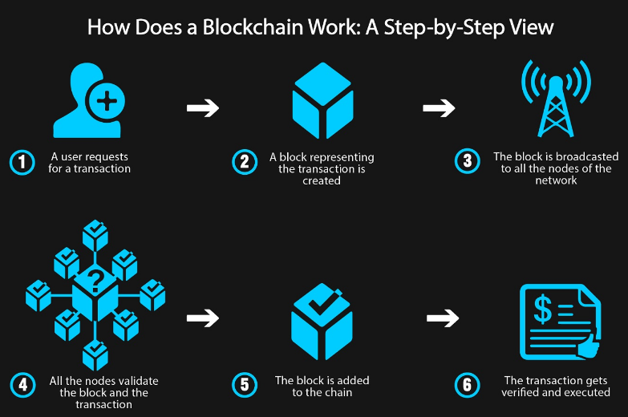
Blockchain Impact on Accounting:

Slide 24
Blockchain Impact on Accounting:
The ownership and the transactional history becomes one and the same.
Bank reconciliations become obsolete, transaction clearing is essentially reduced to time zero.
In the traditional model entities keep their own version of events in their own accounting system. In the blockchain model, entities will have a shared version of the truth.
For example, a vendor customer relationship will share one version of transactions and potentially eliminate reconciliation.
Notes:
SAGE recently bought Intacct
Currently at Kiwi:
QBO
QBE/QBD
Xero – 2 or 3 clients
Intacct – 3
FE
FundEZ

Slide 25
Blockchain Impact on Accounting:
Instead of a customer and vendor each keeping a ledger related to the transactions between them, blockchain allows them to share one version of events on one ledger without the need to reconcile.
A controller no longer has to reconcile in the traditional sense of bank accounts.
Cryptocurrency eliminates settlement time and therefore the need to reconcile.
Controllers can focus on higher value work.
Notes:
Open API integrations

Slide 26
Blockchain Impact on Accounting:
Accountants have a greater opportunity for value added services as non-value added tasks are automated or eliminated.
Currently the Bitcoin blockchain is an immutable ledger but it’s not inherently a double entry accounting system.

Slide 27
Blockchain Impact on Accounting:
A blockchain is more like a single entry system recording only the “cash” side of the journal entry between two parties.
“Triple entry accounting” is a term to describe double entry accounting plus blockchain, with blockchain as the third entry.

Slide 28
Blockchain Impact on Accounting:
Accounting Journal Entry
Blockchains are inherently a single entry system. The following is a bitcoin transaction sent from Company A to Company B for a $1,000 computer. The is the ”entry” on the blockchain.
Company A dr. cr.
Bitcoin (in USD) $1,000
Company B
Bitcoin (in USD) $1,000

Slide 29
Blockchain Impact on Accounting:
This is the journal entry Company A and Company B have to make in their respective accounting systems.
Company A dr. cr.
Bitcoin (in USD) $1,000
Equipment $1,000
Company B dr. cr.
Bitcoin (in USD) $1,000
Sales $1,000

Slide 30
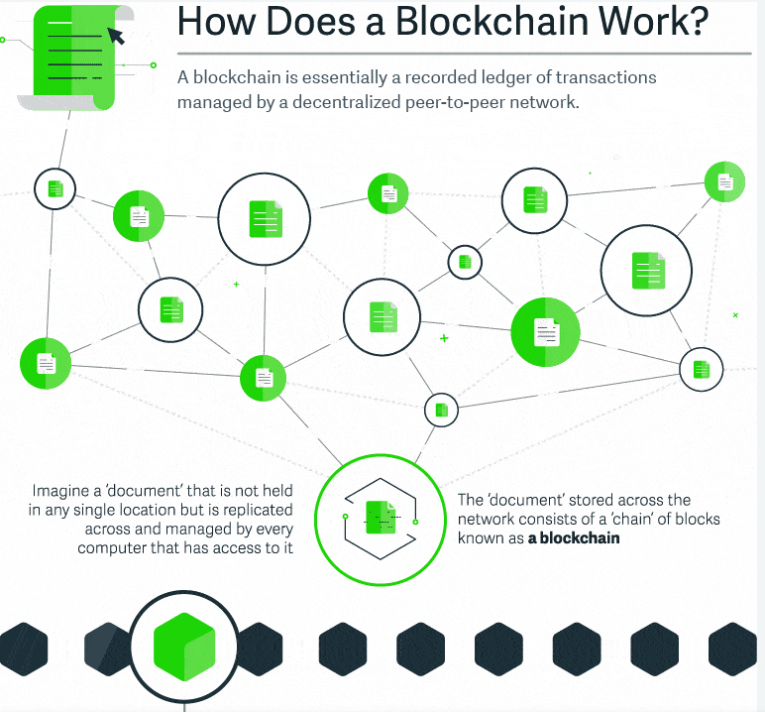
How Does a Blockchain work?
Blockchain is the underlying technology behind digital currency. For nonprofits, their first initiation into the world of blockchain technology is accepting donations of cryptocurrency, such as BitCoin, Ethereum, or Ripple.
A Blockchain is a digital ledger created to capture transactions conducted among various parties in a network. It is a peer-to-peer, internet-based distributed ledger which includes all transactions since its creation. It’s hailed for its transparency and accountability because any changes to a public blockchain can only be seen, or even authorized, by others along the chain.
Sage Intacct and other similar technology innovation based companies have a strong use cases to implement a Blockchain technology in a very near future
Notes:
I had a PtoP conversation with Aaron Harris (Sage CTO) and he confirmed on Sage Intacct is strongly investing and developing the blockchain technology as a module allowing other vendors to do direct API in future

Slide 31
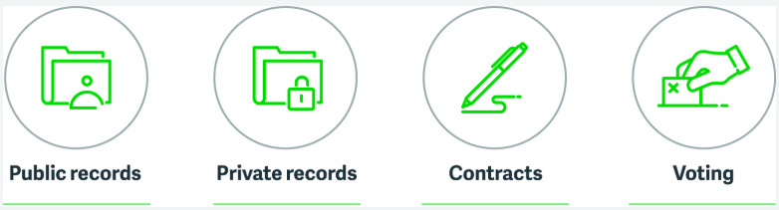
Blockchain uses beyond cryptocurrency
Similar to the Internet, blockchain is set to significantly disrupt industries and transform how companies conduct business. Some of blockchain’s current applications include:
Smart contracts
Self-automated and extremely secure software that can facilitate, verify, and process contracts without a governing authority.
Payment and money transfers
Blockchain can also safely and securely facilitate cross-border payments in real time.
Distributed cloud storage
Since it’s impossible to corrupt or change data once entered, blockchain could also enhance the security of cloud storage.
Notes:
Smart contracts
Self-automated and extremely secure software that can facilitate, verify, and process contracts without a governing authority. Smart contracts make it faster, easier, and cheaper to create agreements between multiple parties. Companies like Share&Charge, Propy, and Fizzy AXA already use smart contracts to automate payment processes, facilitate international property purchases, and process insurance claims.
Payment and money transfers
Blockchain can also safely and securely facilitate cross-border payments in real time. At present, more than 1000 financial institutions including big names like Santander and Royal Bank of Canada, use Ripple’s blockchain technology to send and receive money.
Distributed cloud storage
Since it’s impossible to corrupt or change data once entered, blockchain could also enhance the security of cloud storage. Similar to cloud-based accounting software, multiple users can access the information from online portals. However, unlike the cloud, users would need a unique key to access the data, offering customers higher levels of privacy and reliability as well as lower costs than current cloud systems. Storj is one company currently offering this service.

Slide 32
Blockchain Impact on Accounting:
To Be Continued …
Hot and Cold Wallet
Private and Public Blockchain, or hybrid
ICO and regulations
Securities
Real-time audit, decreasing fraud to 0%
Smart Contracts, etc

